Slide 1
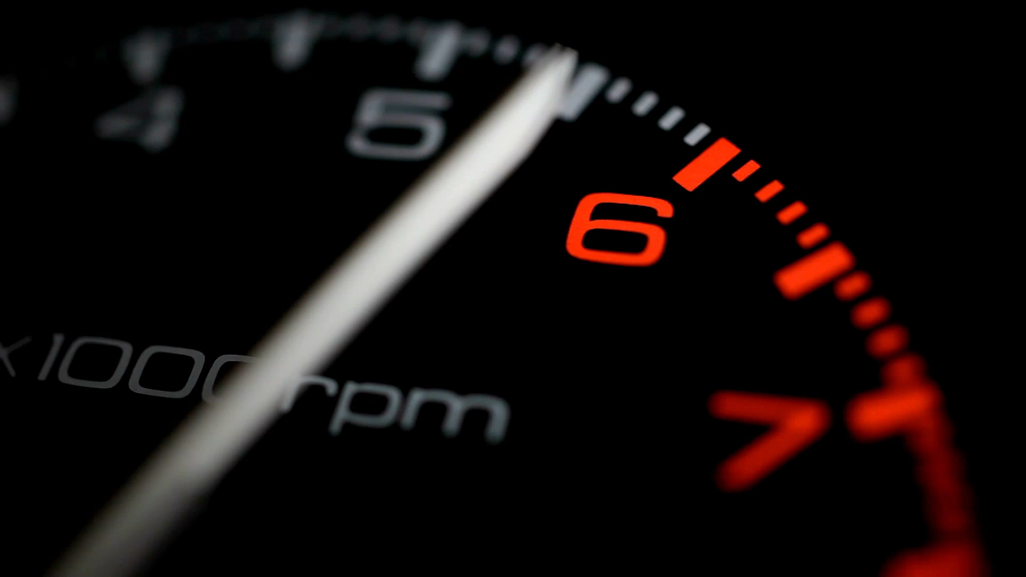
Monitoring Engine Health Through Better Fuel Consumption

Slide 2

About Data-Frame
The dataset comprises CSV data containing ten vehicle signals logged via the OBD-II interface: Engine coolant temperature, intake manifold absolute pressure, engine RPM, vehicle speed sensor, intake air temperature, air flow rate from mass flow sensor, absolute throttle position, ambient air temperature, as well as the accelerator pedal positions D and E. This comprehensive data was recorded using the OBD-II dongle KIWI 3 from PLX Devices in conjunction with the smartphone application OBD Auto Doctor from Creosys on an iOS device. The information-rich dataset offers a holistic view of vehicle performance metrics and environmental parameters captured through OBD-II logging, facilitating detailed analysis for insights into automotive behavior, performance trends, and environmental interactions.
Dataset Shape : 2693K Rows , 14 Columns

Slide 3
1st learning from Project 1
Recommend on the dependent variable where the range of the dependent variable is high.
If above condition is True, the variable should be directly proportional to Fuel Mass Consumption
Fuel mass range : ~10
Air flow rate from Mass flow sensor [g/s] : ~100
&
Air Flow Rate(g/s) ∝ Fuel Mass Consumption

Slide 4


2nd learning from Project 1
Beware of IDLE Conditions
Better Recommendation Scope

Slide 5
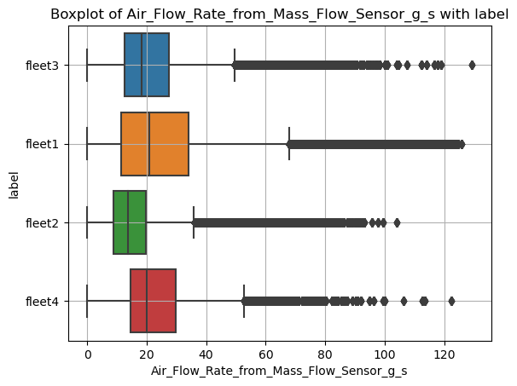
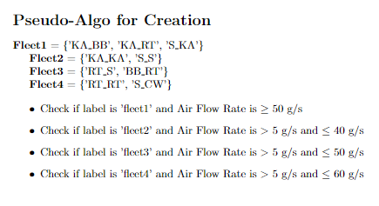
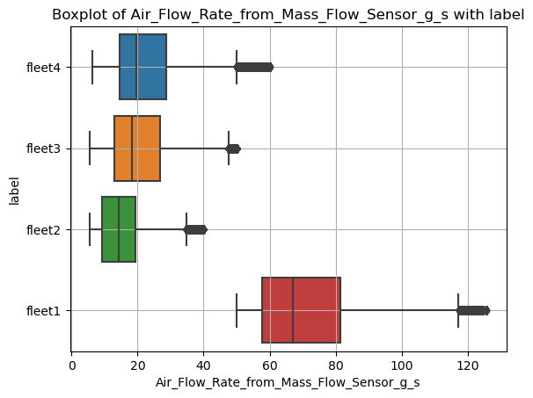
Creating Problem Statement
I/P
O/P
Our project involves the utilization of a comprehensive dataset encompassing a diverse range of engine types. To facilitate data analysis and enhance fuel efficiency, we initiate our methodology by segmenting the dataset into distinct sectors or data frames via filtering techniques. Subsequently, our analysis focuses on identifying the fleet or data frame exhibiting the maximum fuel mass consumption, thereby serving as our primary area of optimization.

Slide 6

Understanding the Whole Solution

Slide 7
Requirement for Solution
Fleet 2
For each fleet (i) a Regression model (i) , where i <- {2,3,4}
Properties required for regression model needed:
No Assumptions on Distribution
Handling of Heteroscedasticity
Less RMSE value
Fleet 3
Fleet4
Let’s assume we have such a model for each fleet…

Slide 8
Taking Similar Trips for Fleet-1
Using NTP’s values for further analysis
Fleet1
Mean()
NTP’s
TP’s
Fleet (i)
Distances
Fleet (i)
NTP | TP
NTP | TP
From the similarity distances , took the distances < 250 , and from that top 500 observations/rows.
Updated for each fleet NTP, with the value of Fleet 1 NTP’s values
NTP’s
Euclidian Distance
Output
Inc. NTP/s

Slide 9
Predicting dependent var from each fleet from the model of the fleet
Fleet (i)
NTP | TP
Y^
Recommendation from each fleet on Trimmable params
Input
Model-(i)
Y^
O/P
I/P

Slide 10
Generating Recommendations from each fleet
Using TP’s values for further analysis
Fleet1
Mean()
NTP’s
TP’s
Fleet (i)
TP
TP
See the change in the distributions of the TP’s , and recommend the change
Recommendation from each fleet on Trimmable params
O/P

Slide 11

Fleet Analysis and Model Training for each Fleet

Slide 12
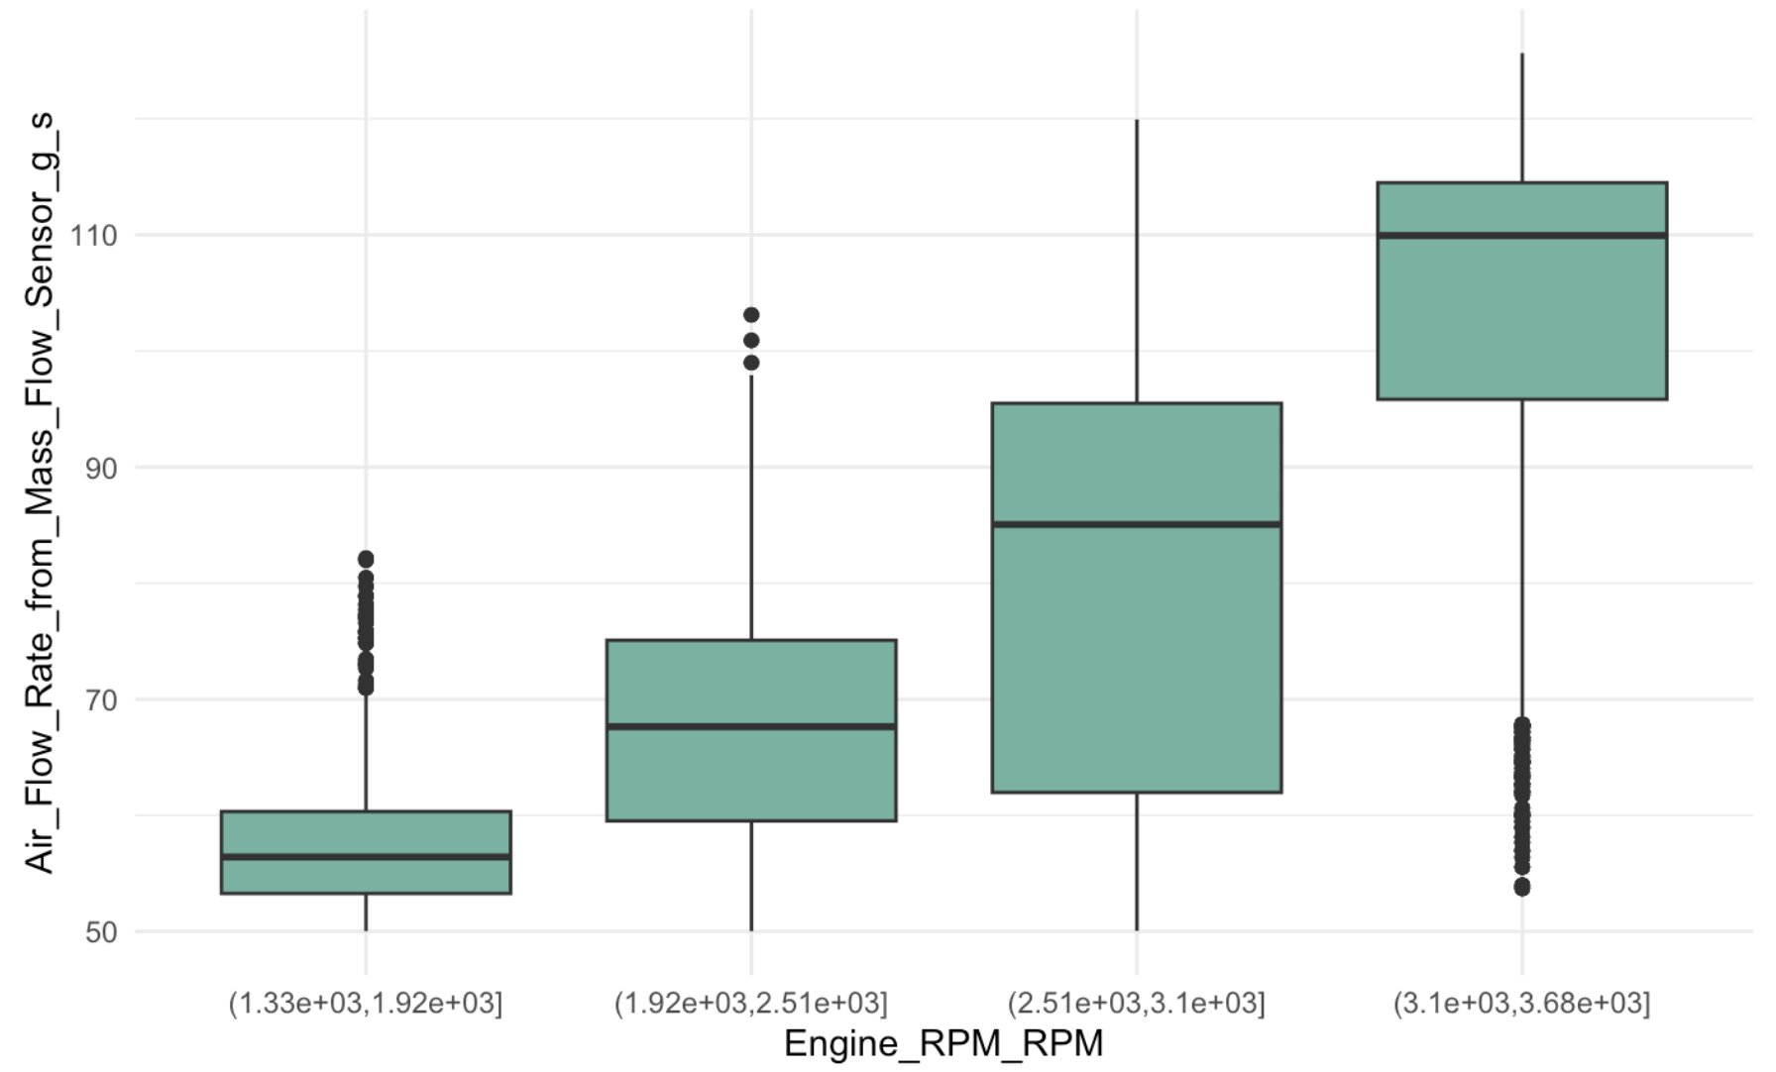
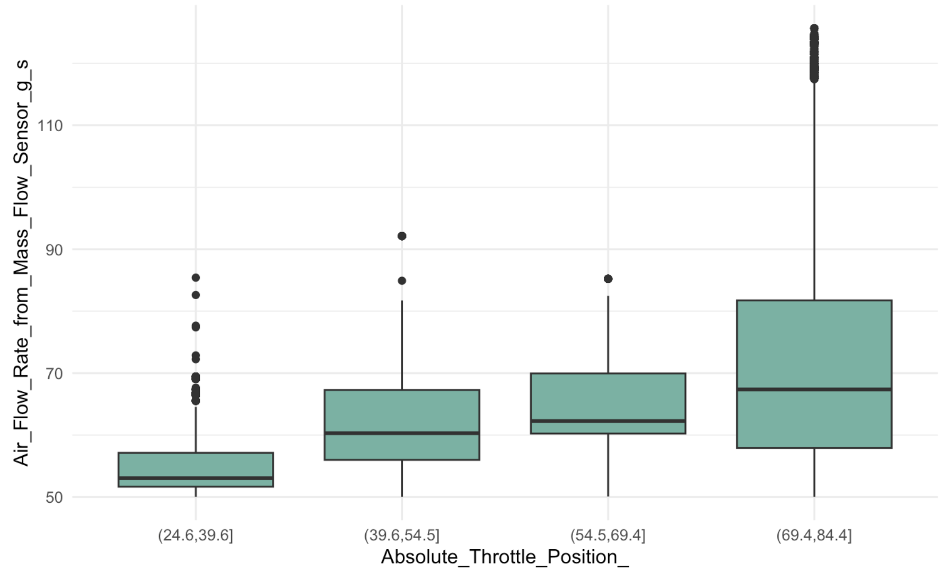
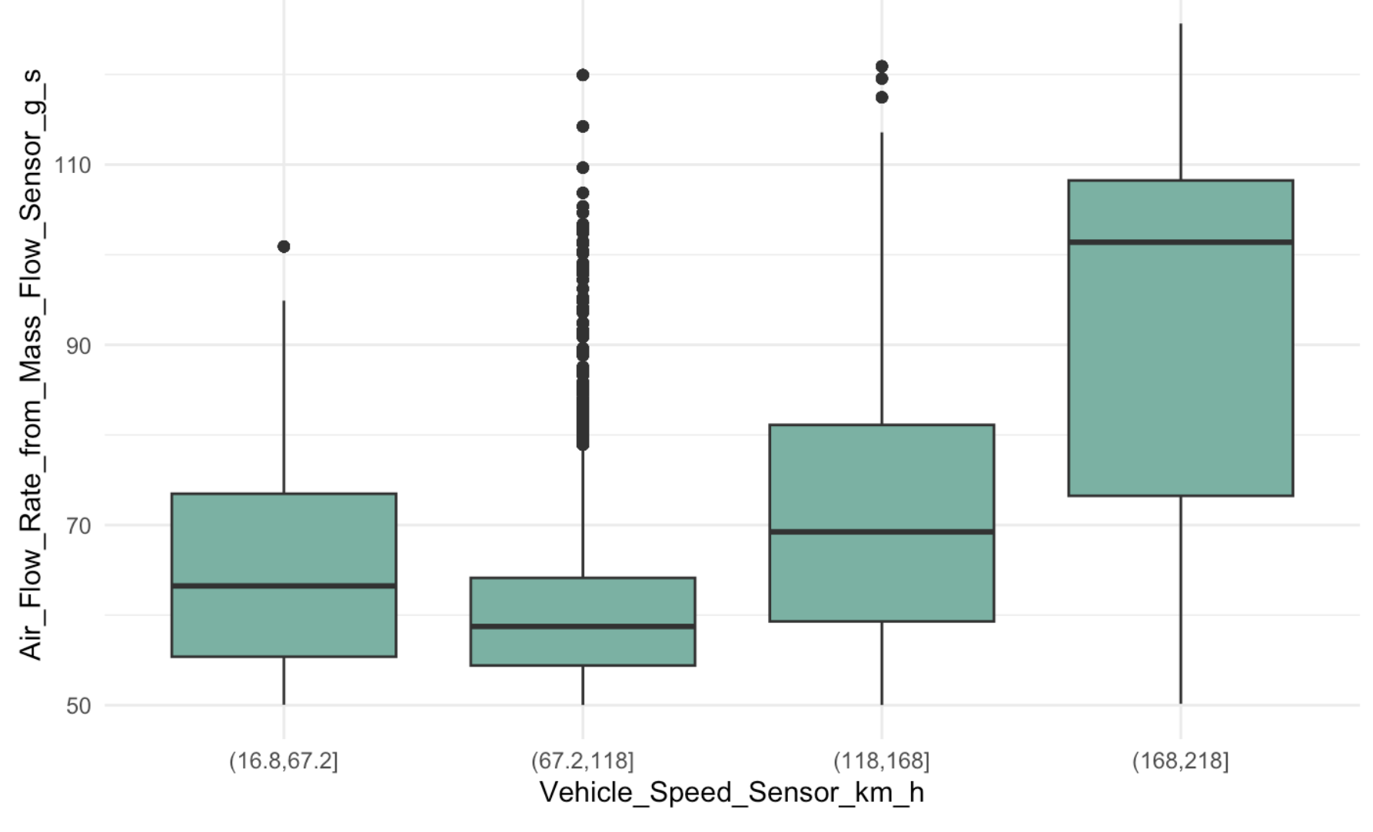
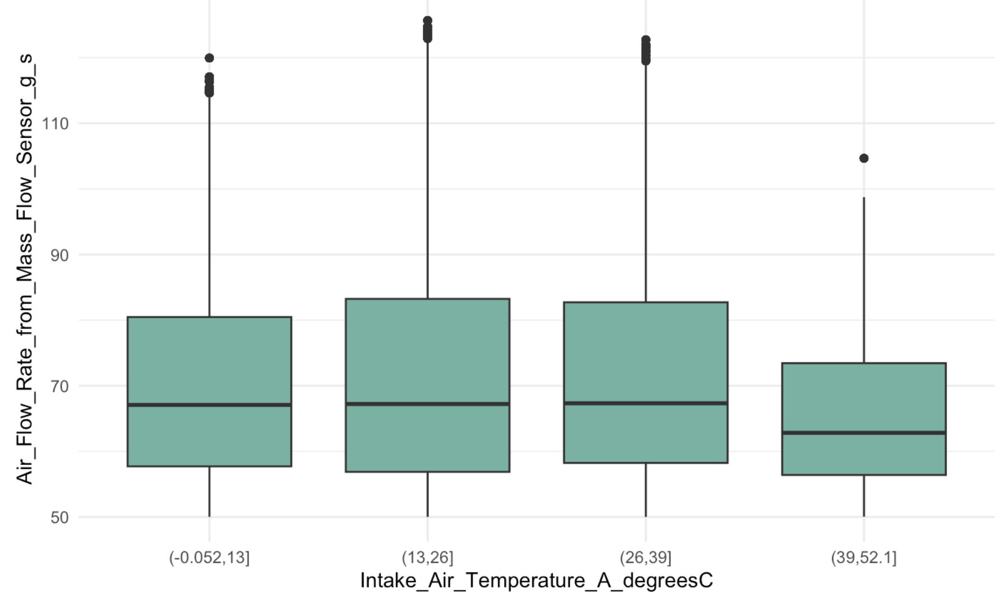
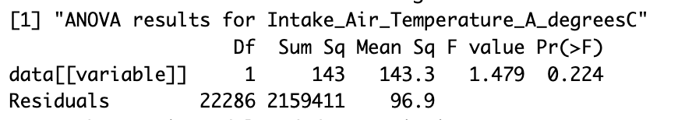
Fleet 1
Not Following

Slide 13
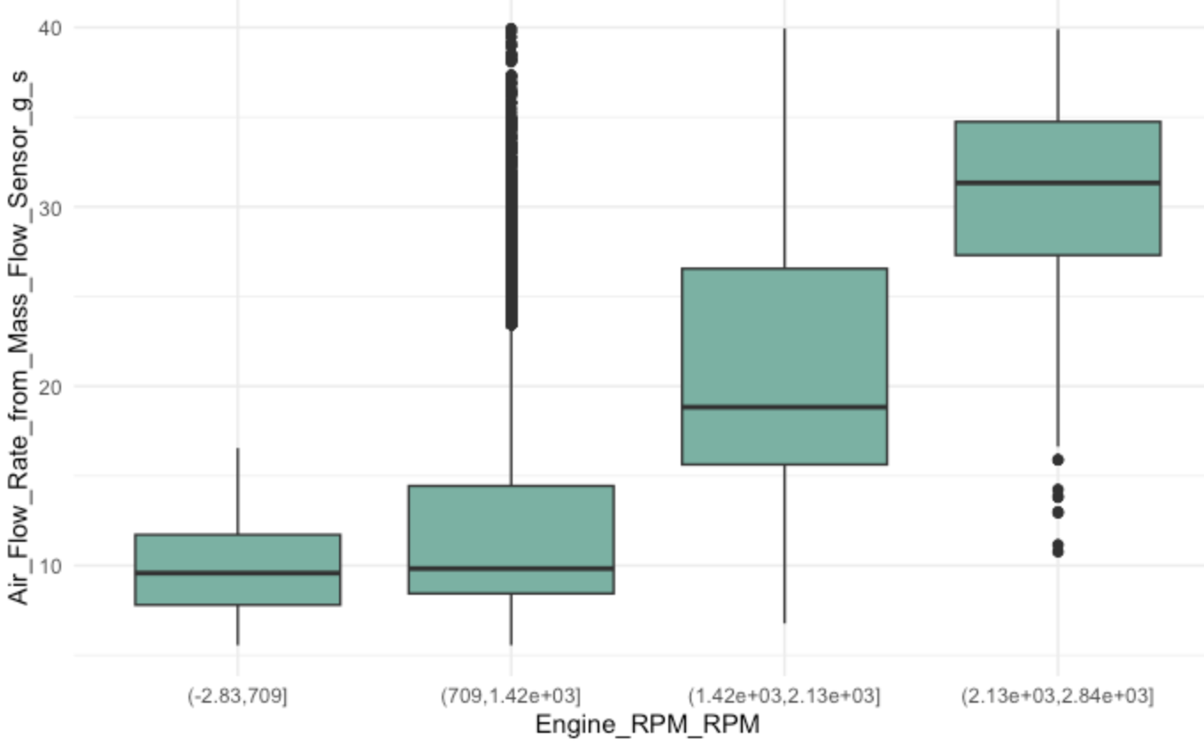
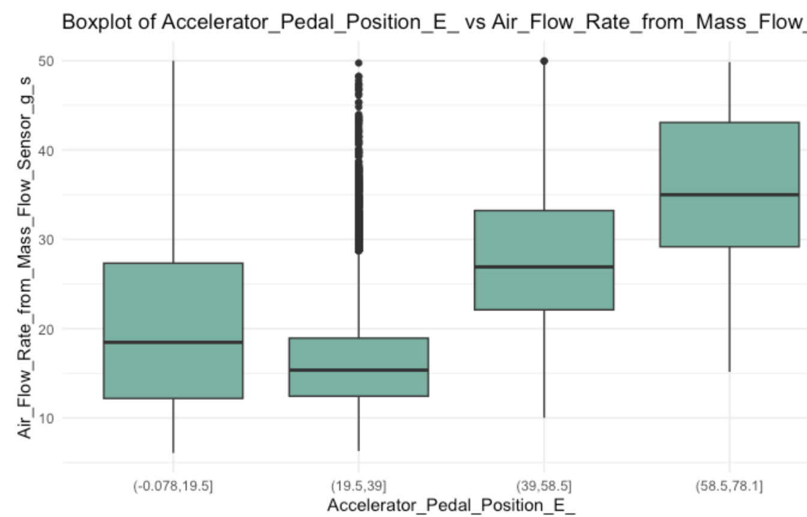
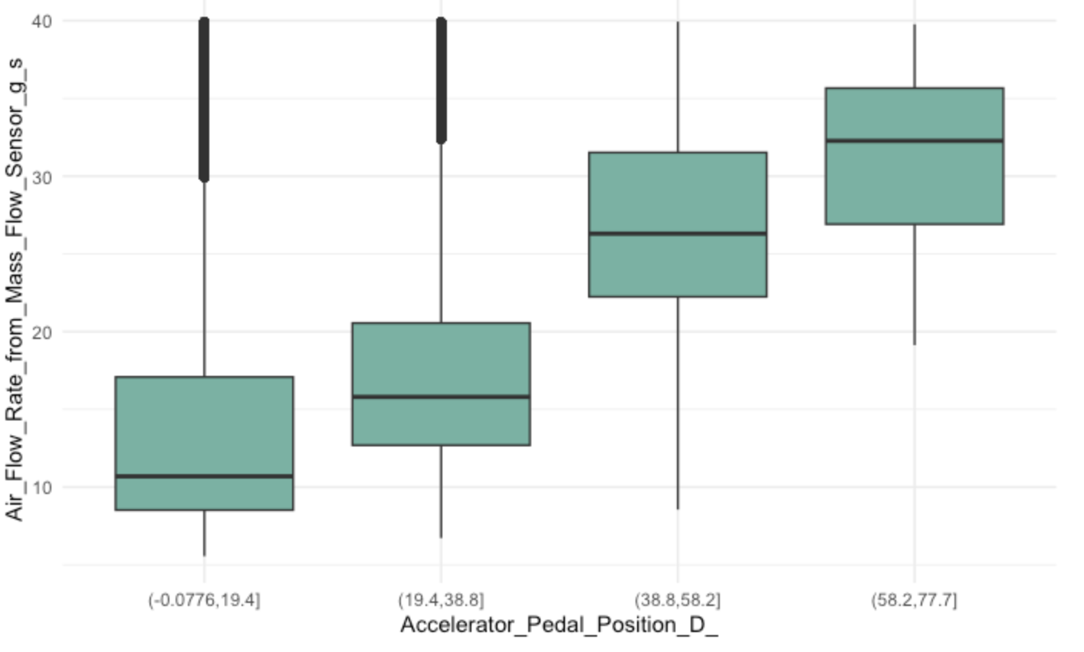
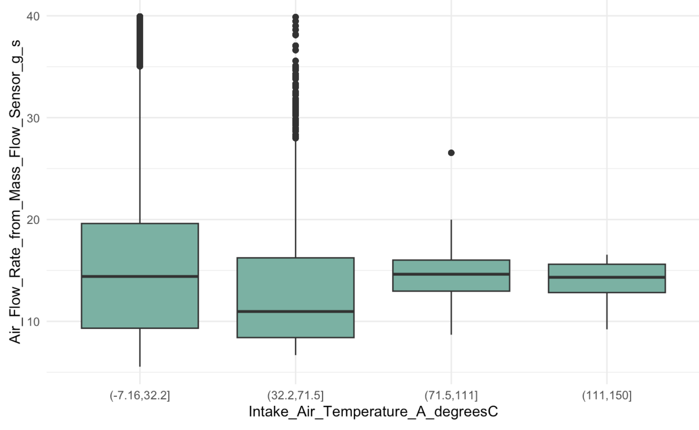
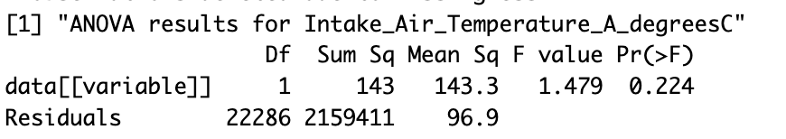
Fleet 2
Not Following

Slide 14
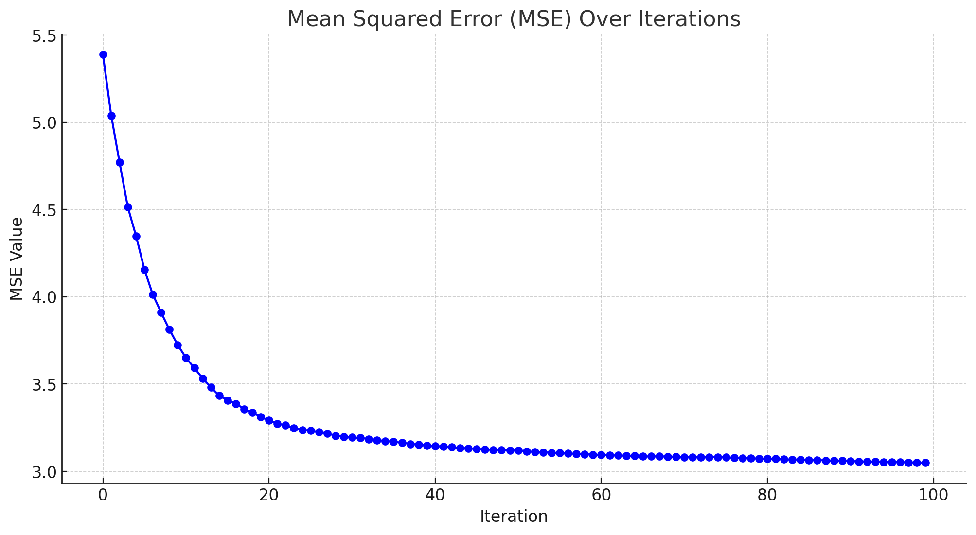
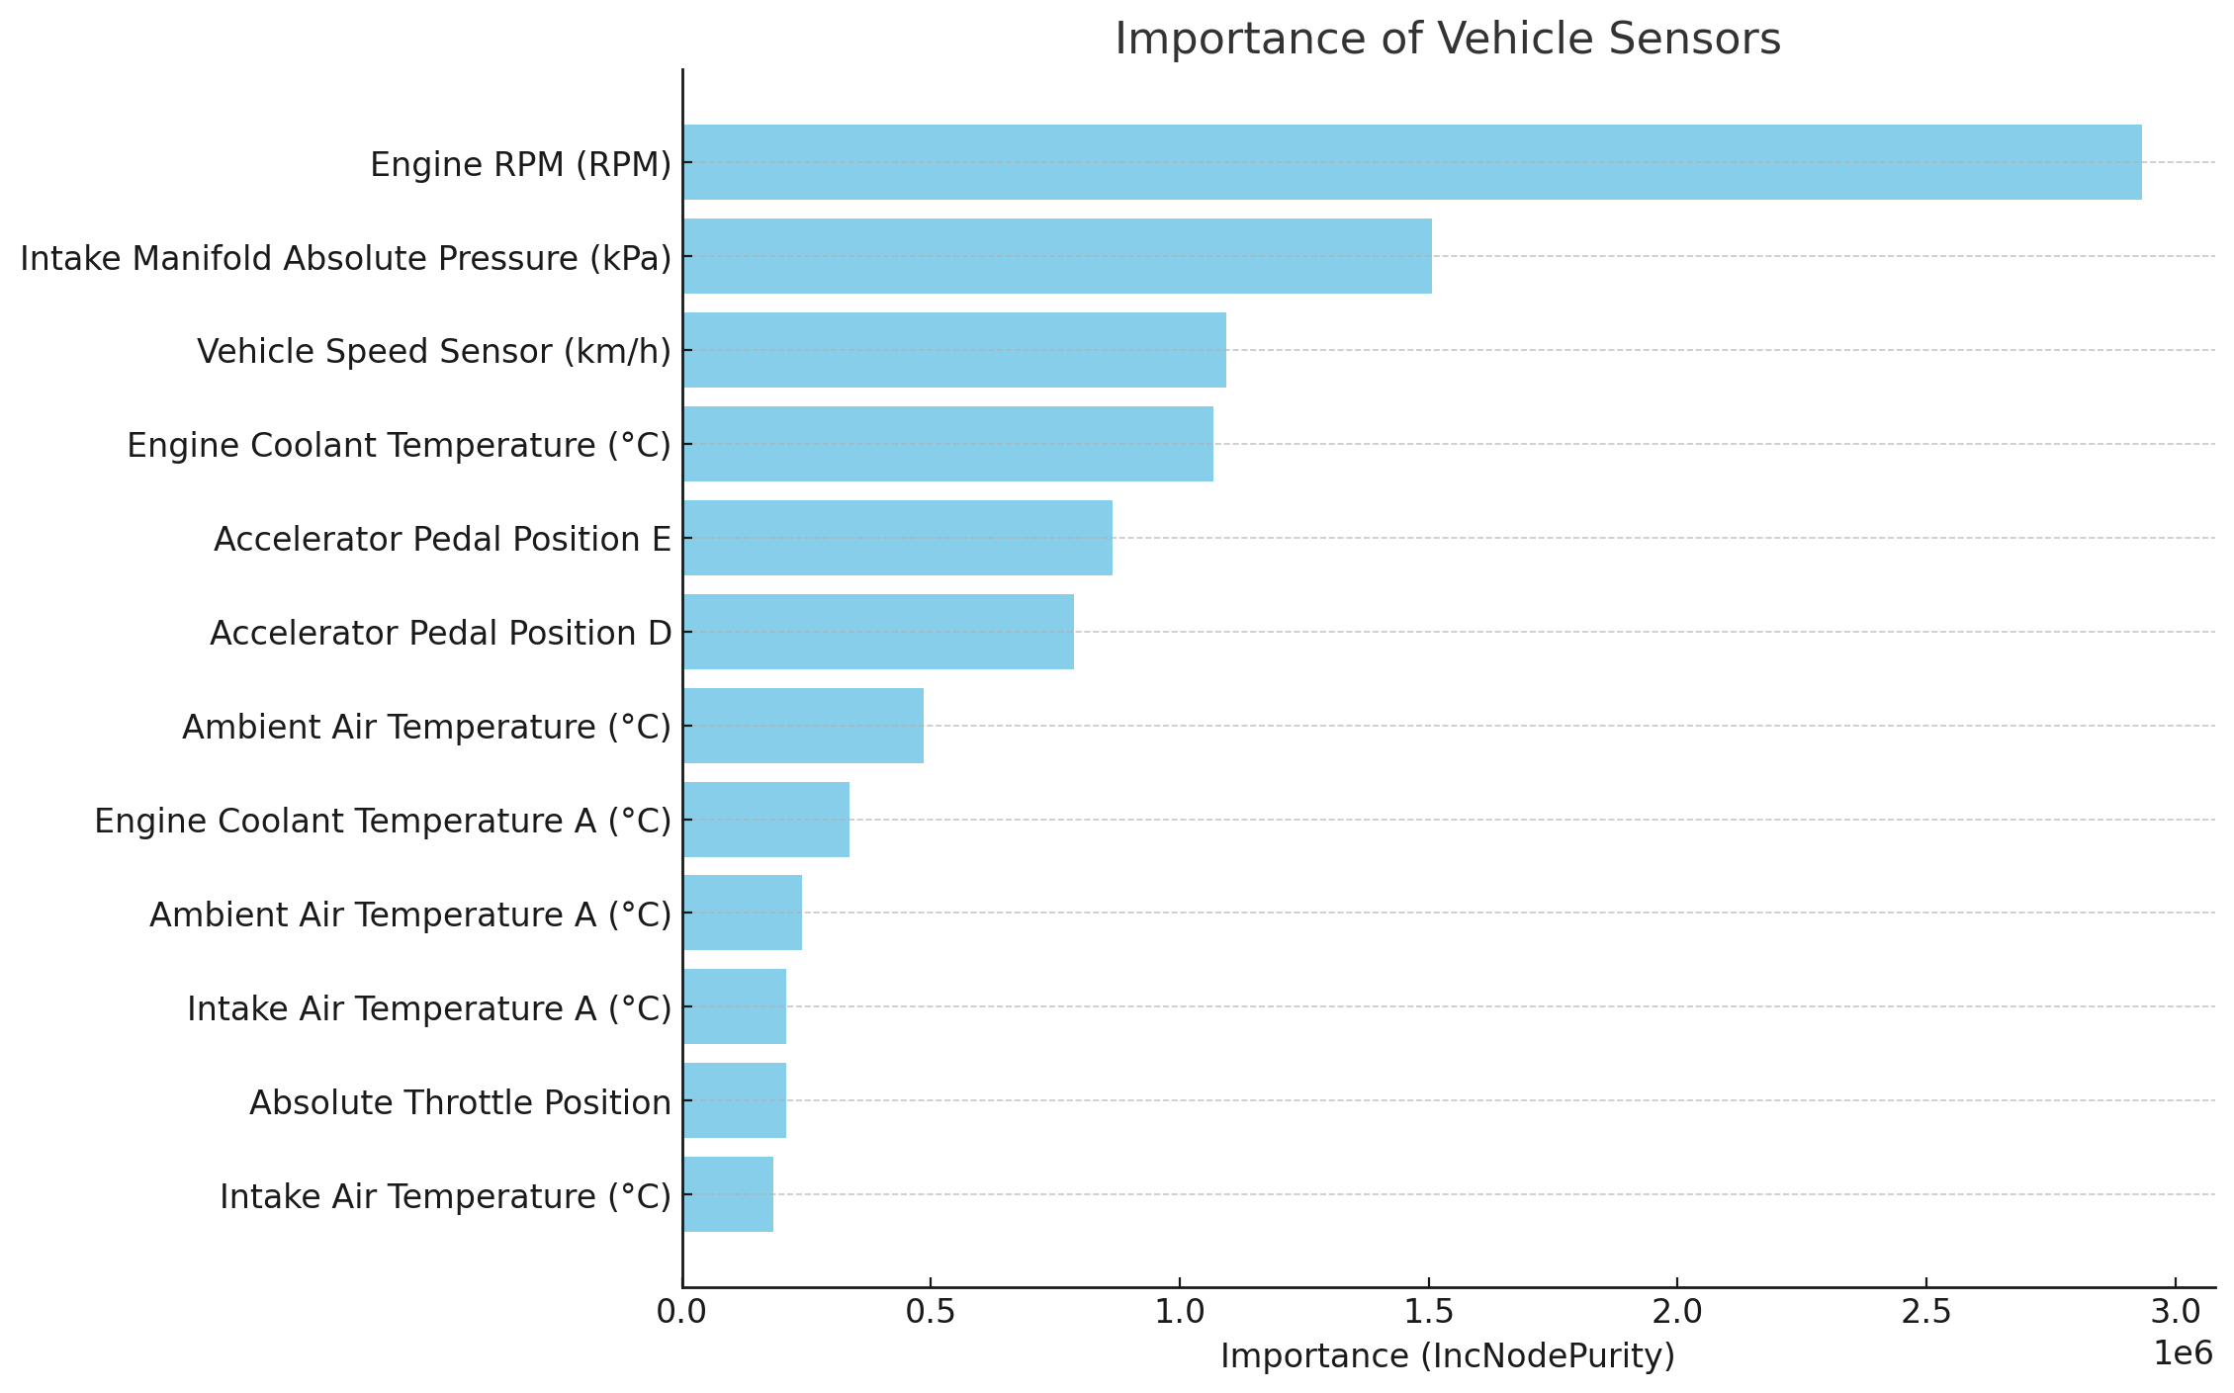
Fleet 2 Model
$call randomForest(formula = Air_Flow_Rate_from_Mass_Flow_Sensor_g_s ~ ., data = train_data, mtry = mtry_val, ntree = 100)
$type [1] "regression"
Training Time: 24 Hours

Slide 15
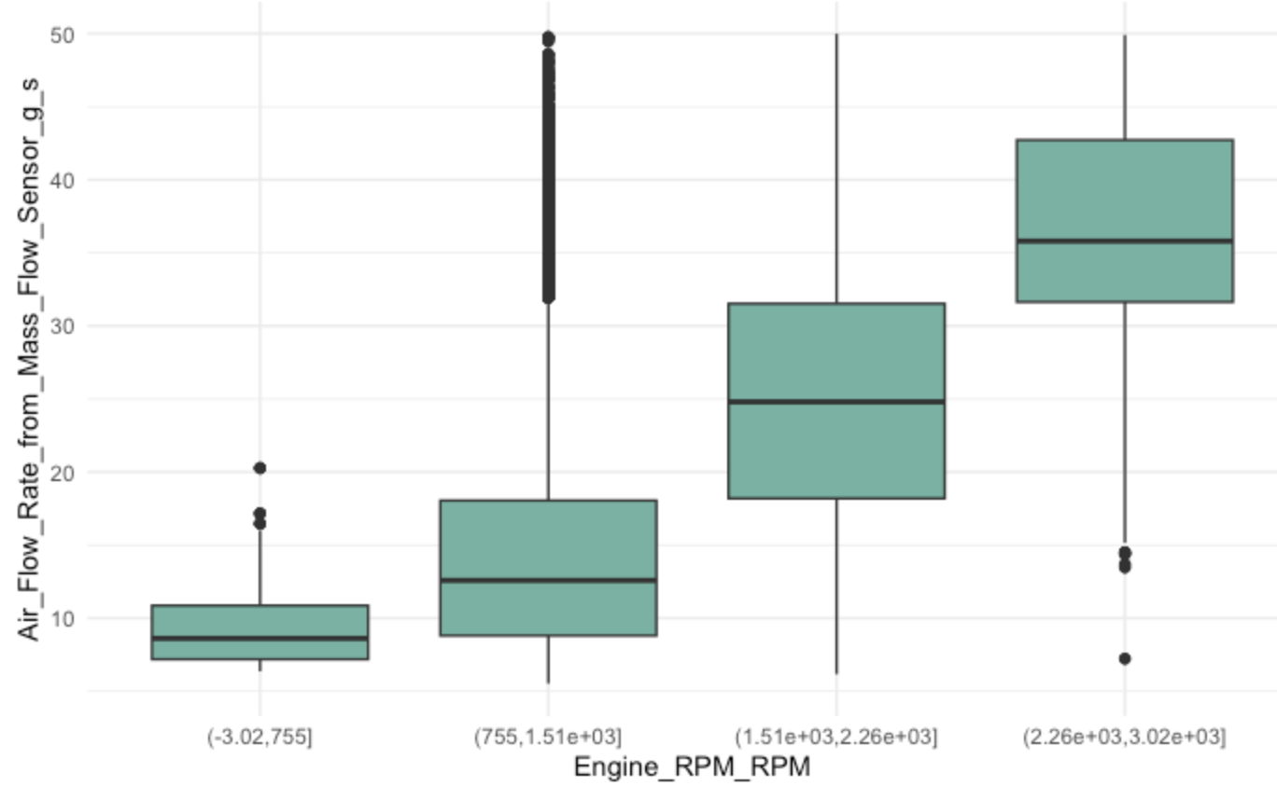
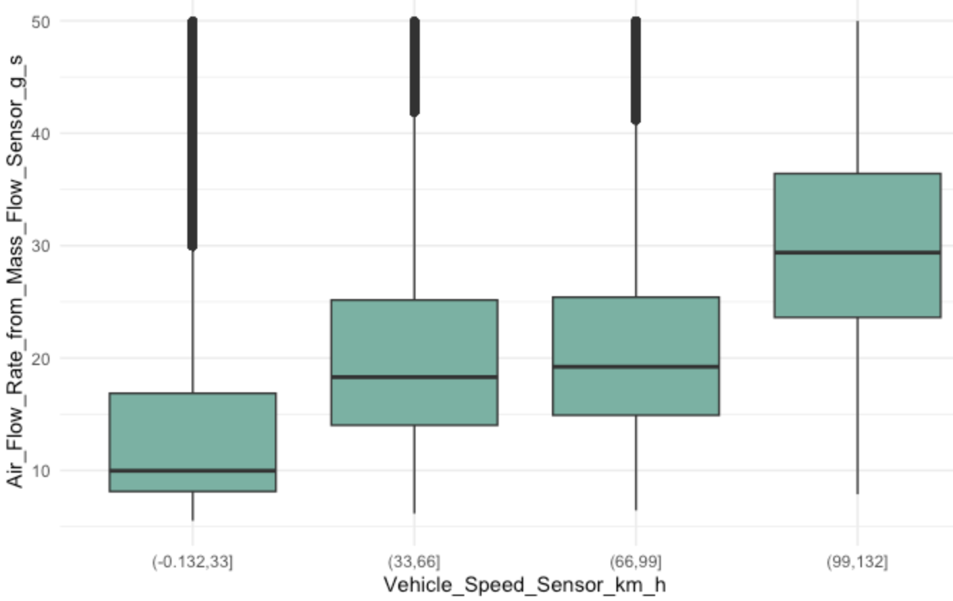
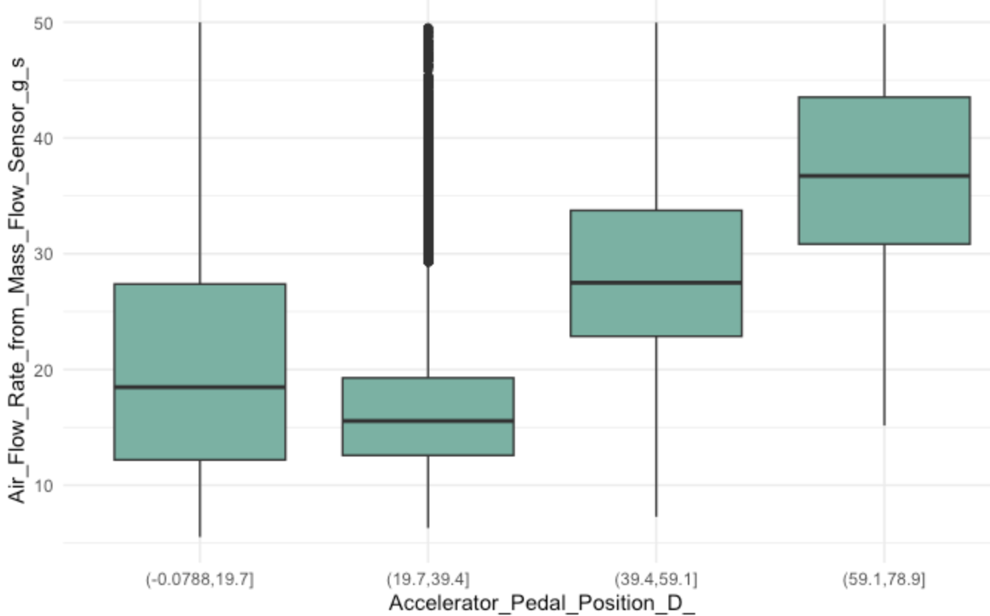
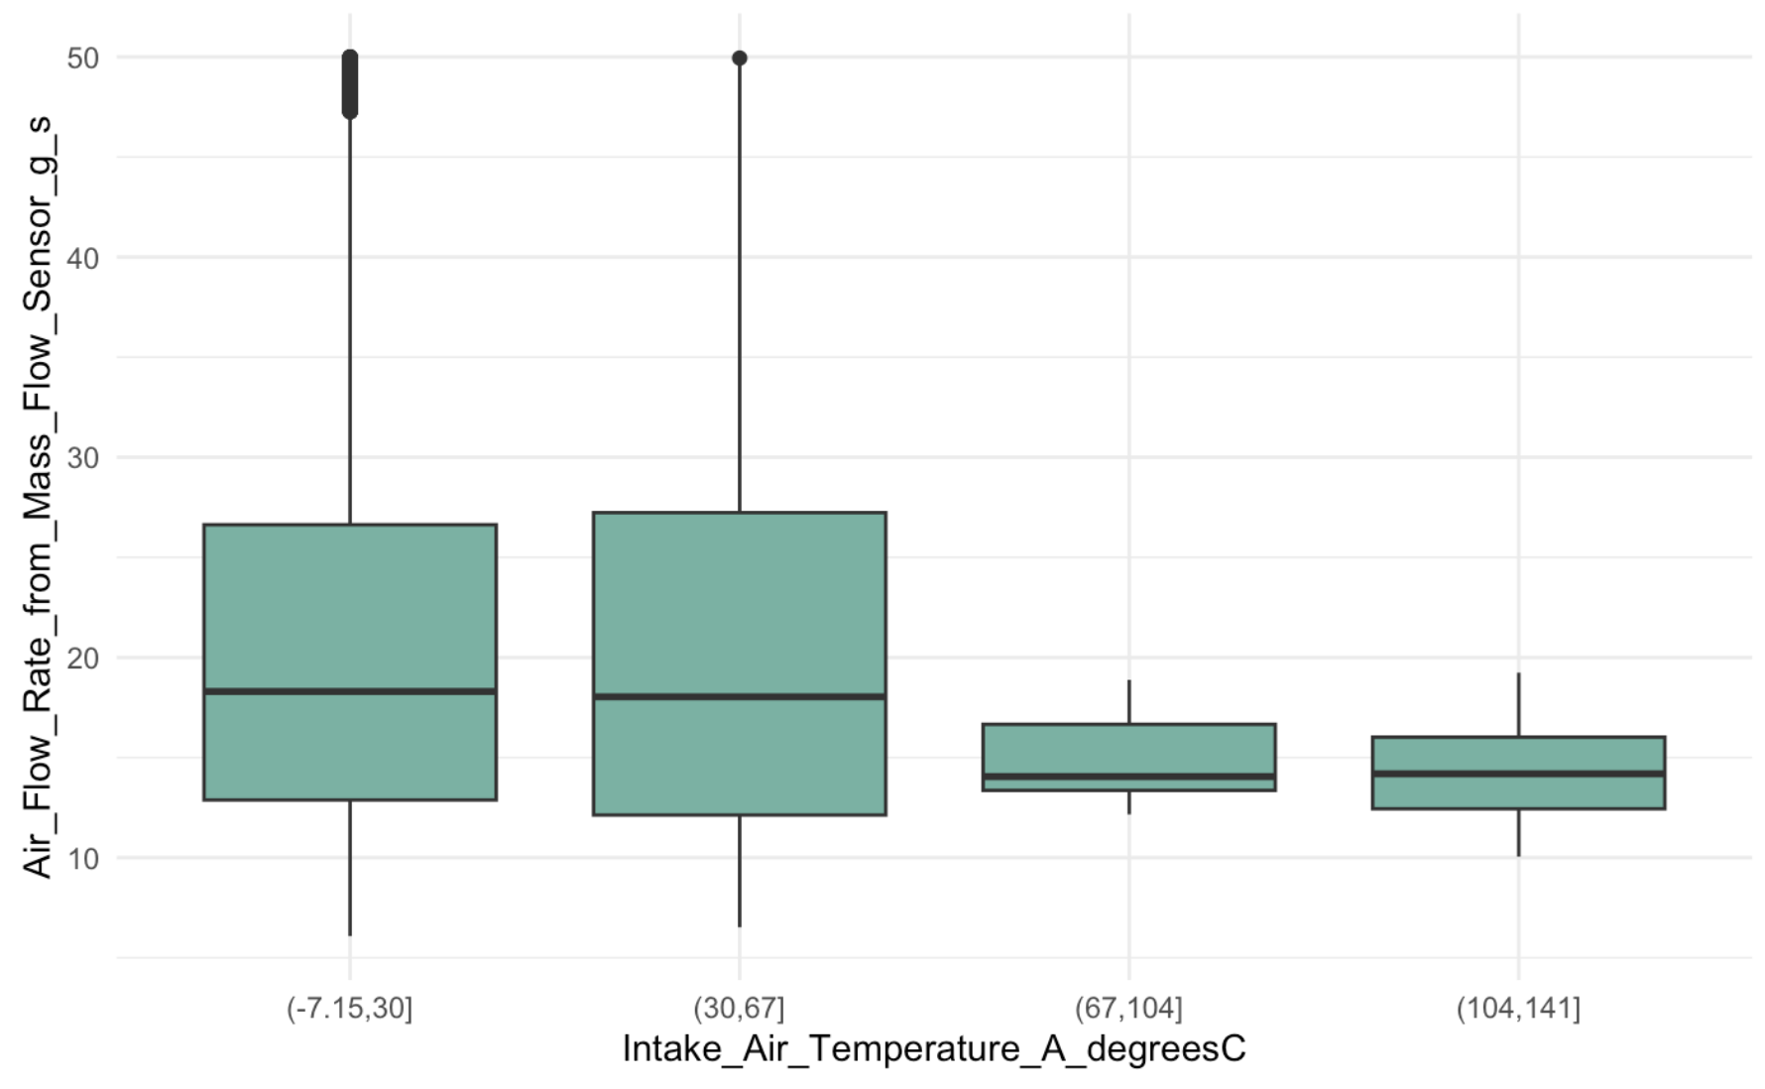
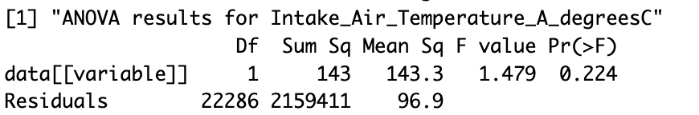
Fleet 3
Not Following

Slide 16
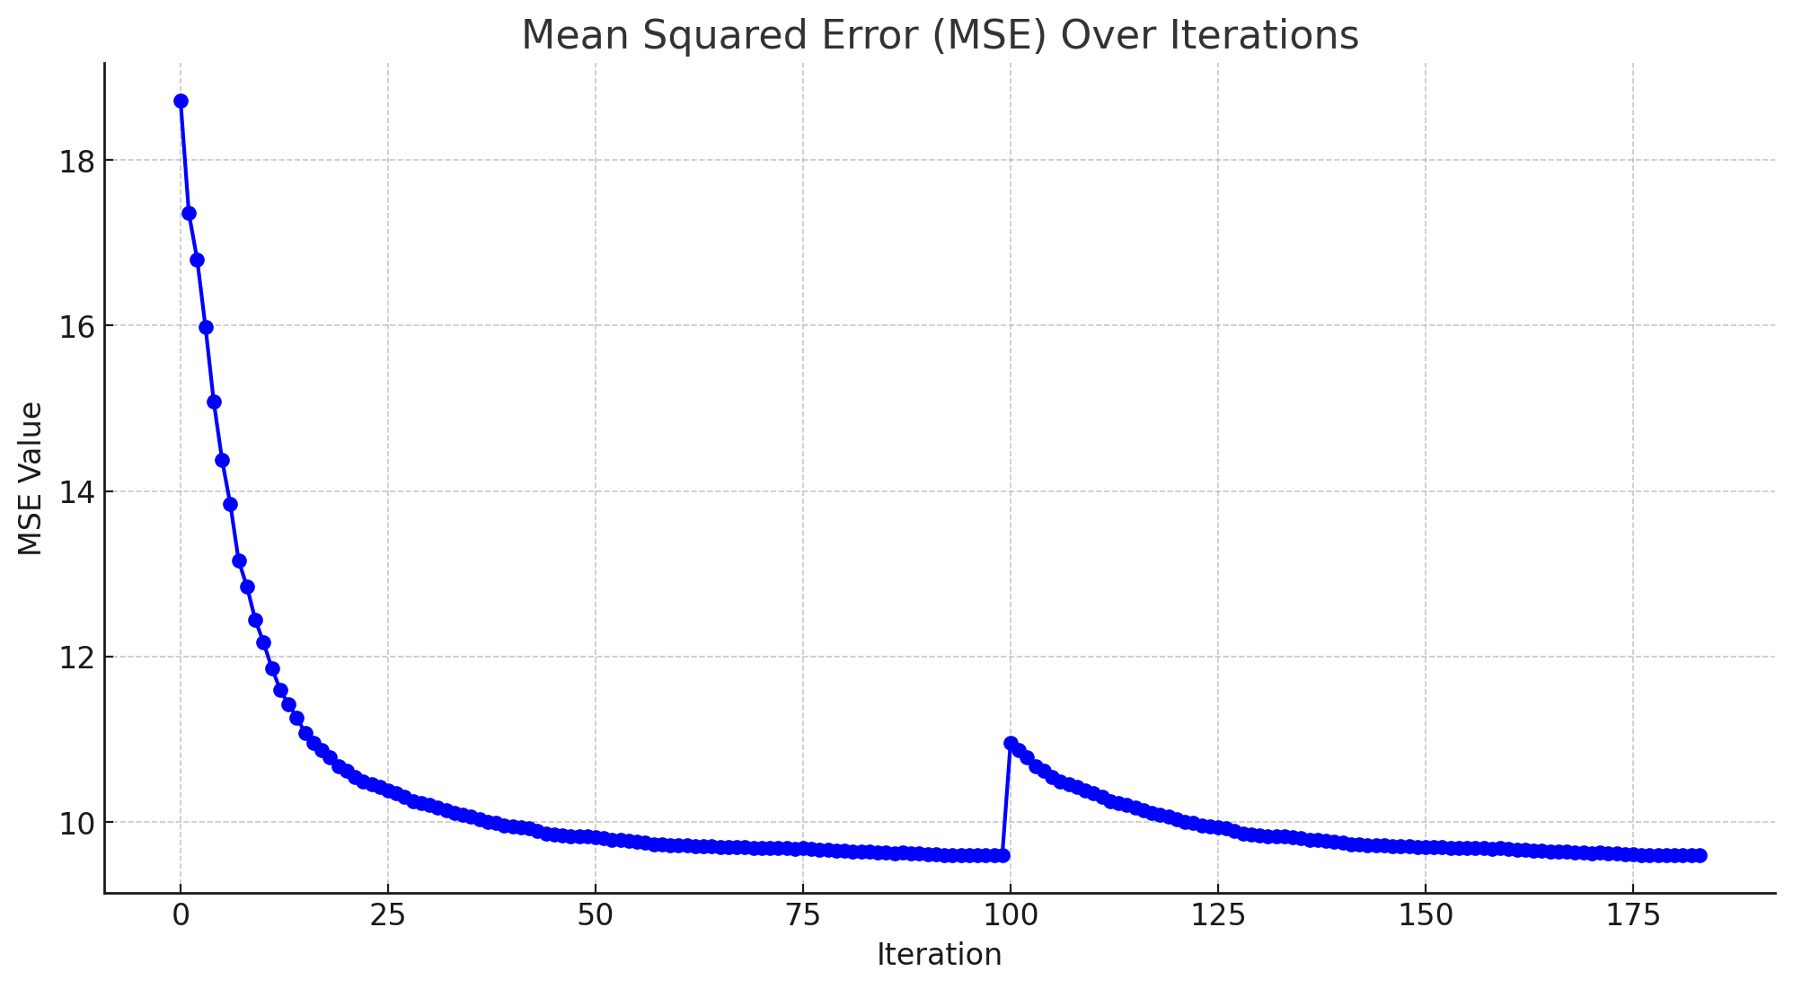
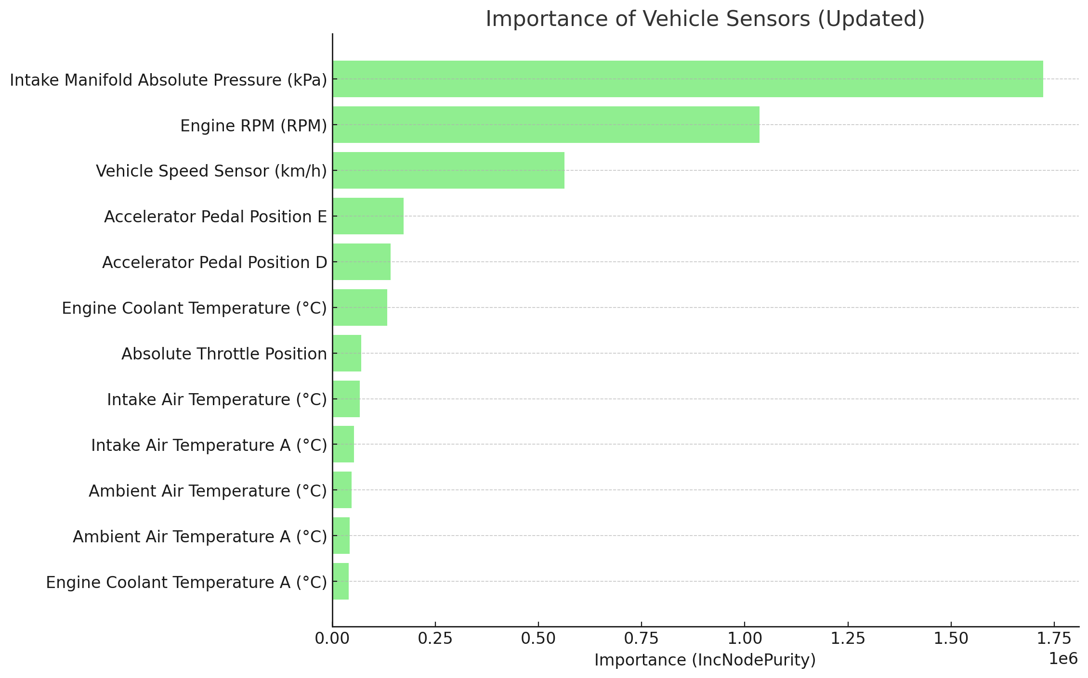
Fleet 3 Model
$call randomForest(formula = Air_Flow_Rate_from_Mass_Flow_Sensor_g_s ~ ., data = train_data, mtry = 4, ntree = 100)
$type [1] "regression"
Training Hours: 24 Hours

Slide 17
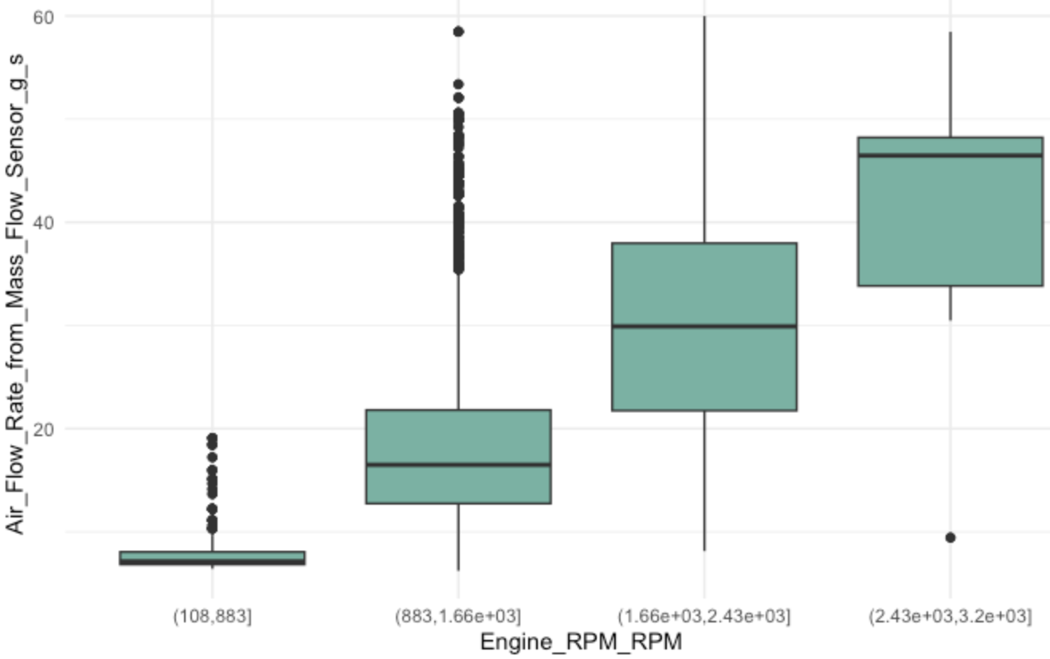
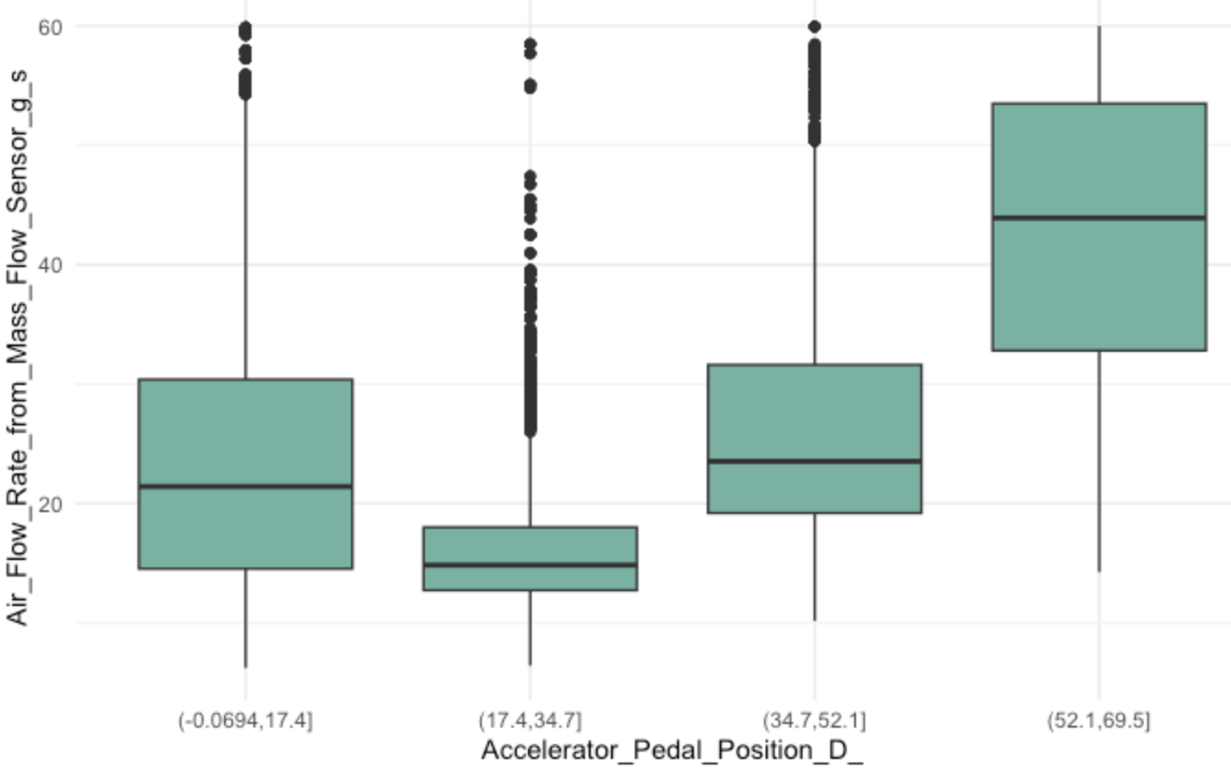
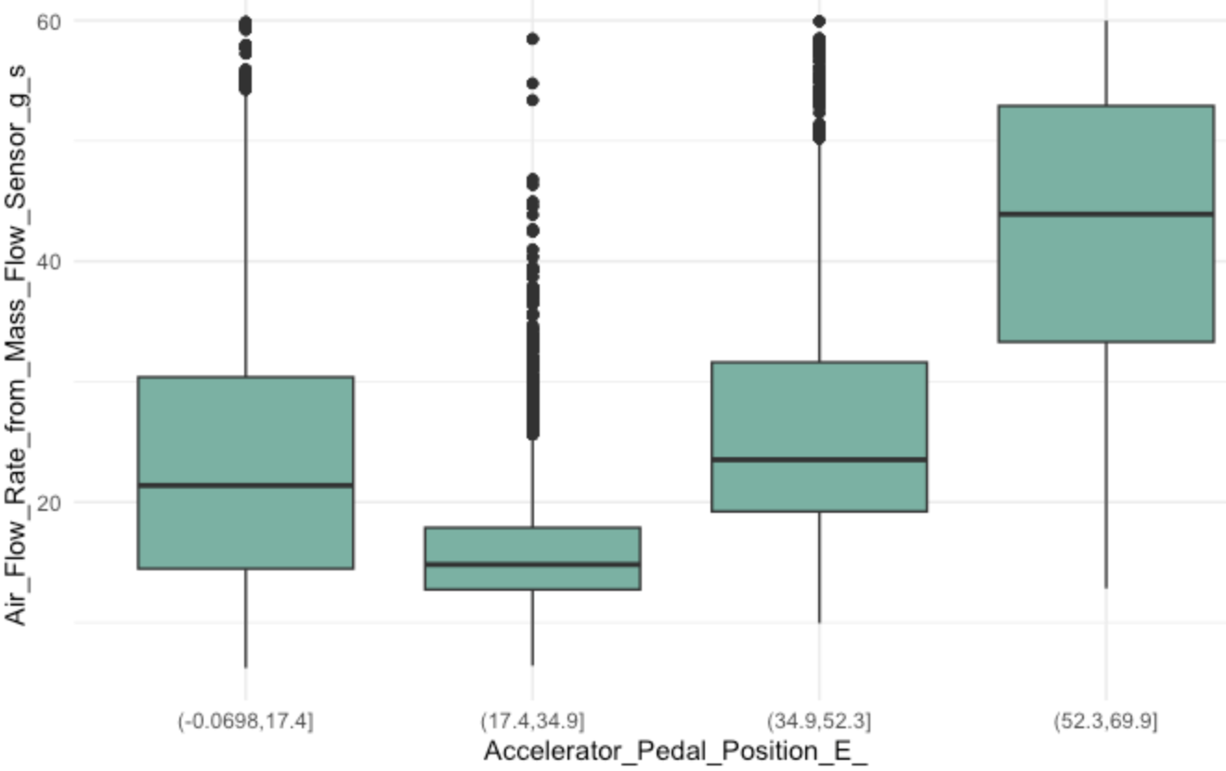
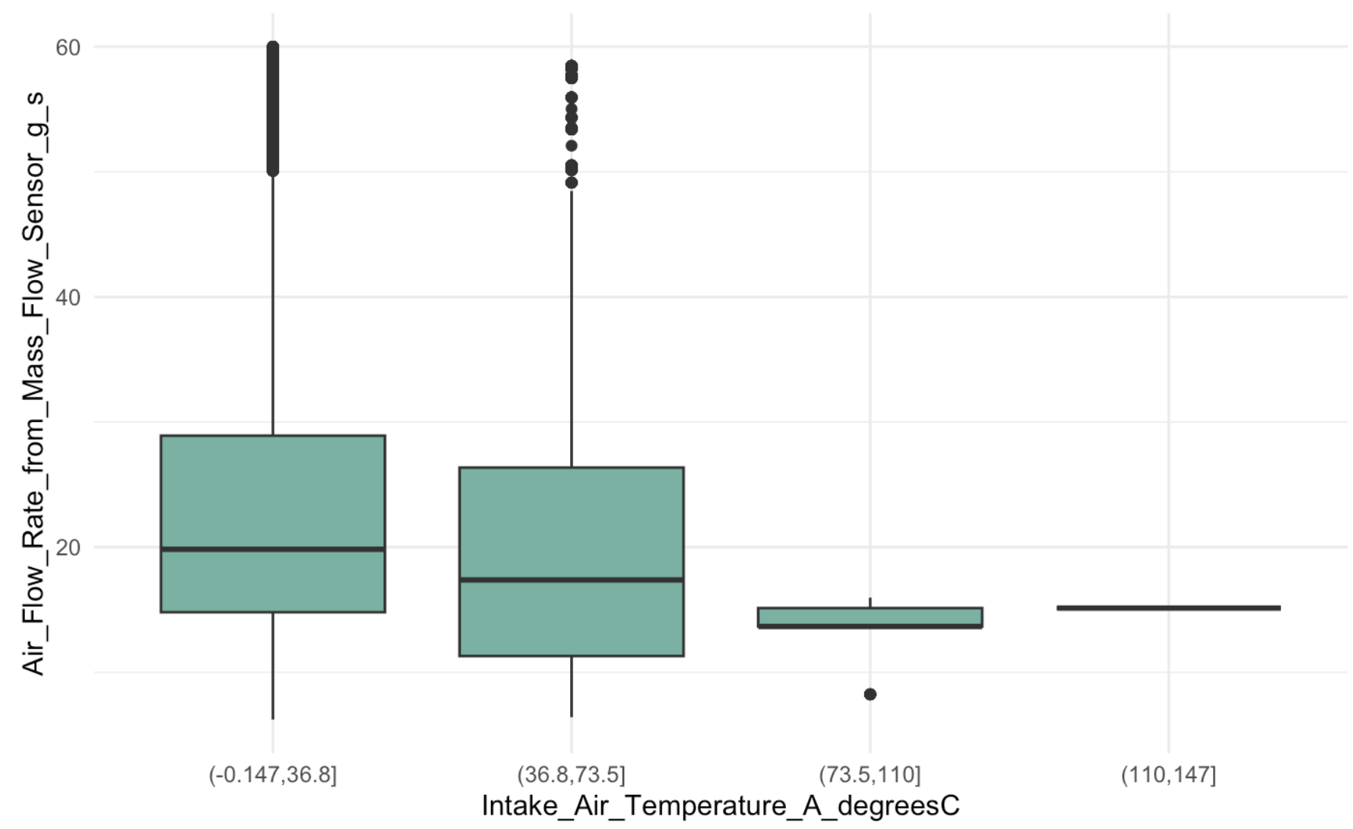

Fleet 4
Not Following

Slide 18
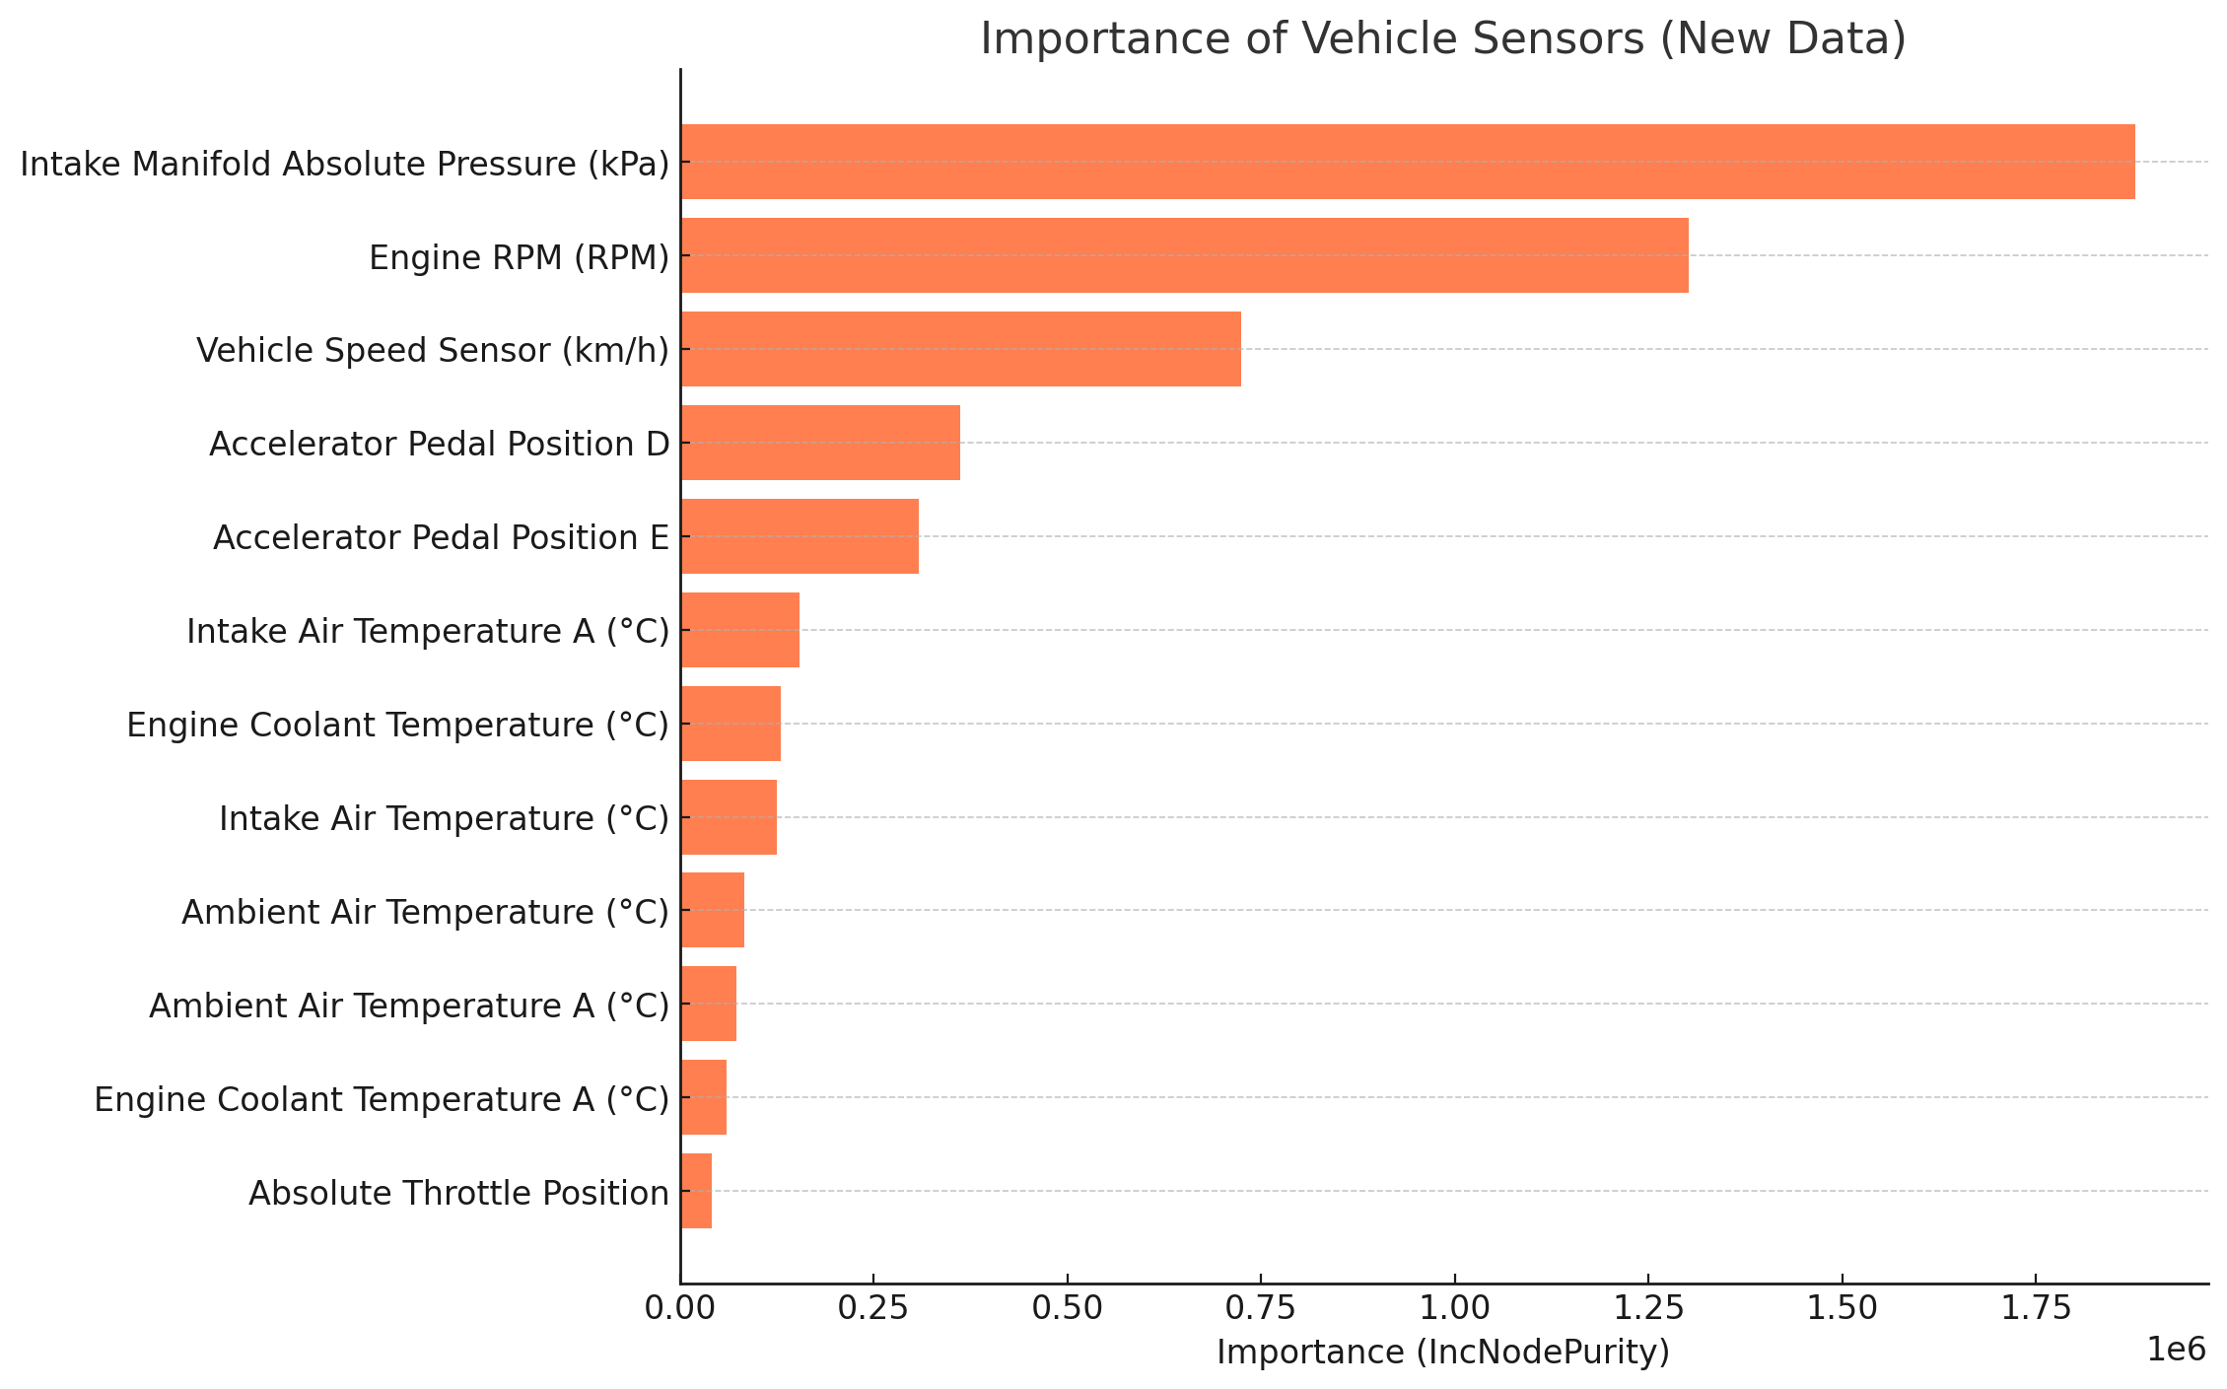
Fleet 4 Model
randomForest(x = x, y = y, mtry = param$mtry)
$type [1] "regression"
Training Time: 24 Hours

Slide 19
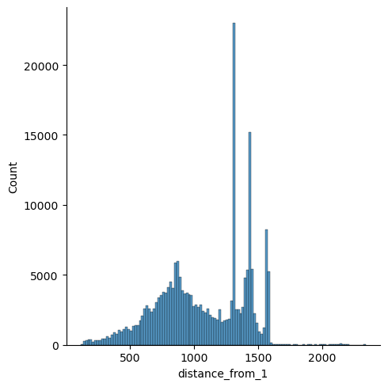
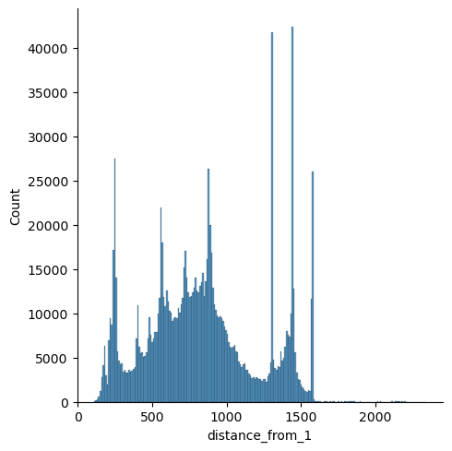
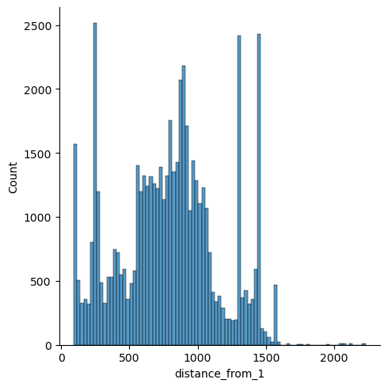
Similarity Analysis for Fleet-1
From Fleet 2
From Fleet 3
From Fleet 4

Slide 20



Creating Recommendations for Fleet 1
Euclidean-Dist ( NTP , row-i) for each row of fleet considering NTP’s of fleet
Similarity based on NTP’s
Fleet 2
Fleet 2
Fleet 3
Fleet 3
Fleet.mean() for Non-Trimmable parameters for Fleet 1
Dist(NTP , fleet_i)
NTP’s
Dist(NTP , fleet_i)
Fleet4
Fleet 4
Dist(NTP , fleet_i)
Overwriting the NTP’s of fleets with fleet1
Fleet 2
NTP’s
TPs
Recommendation from each fleet on Trimmable params
Fleet 3
Model i
Y^
NTP’s
TPs
NTP’s
TPs
Fleet 4
NTP’s
TPs
From the similarity distances , took the distances < 250 , and from that top 500 observations/rows.
Updated for each fleet NTP, value of Fleet 1 NTP’s values

Slide 21
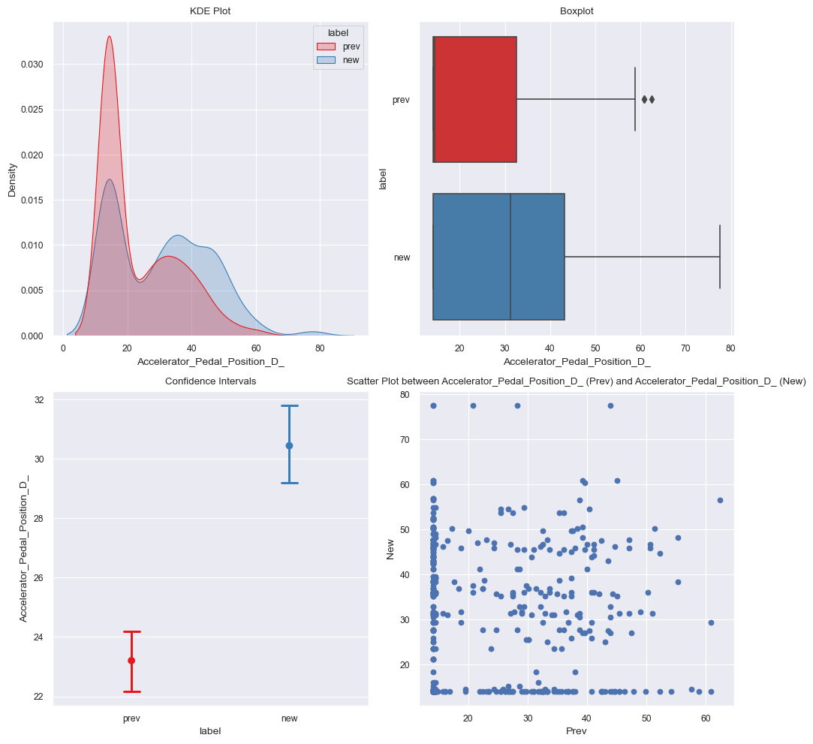
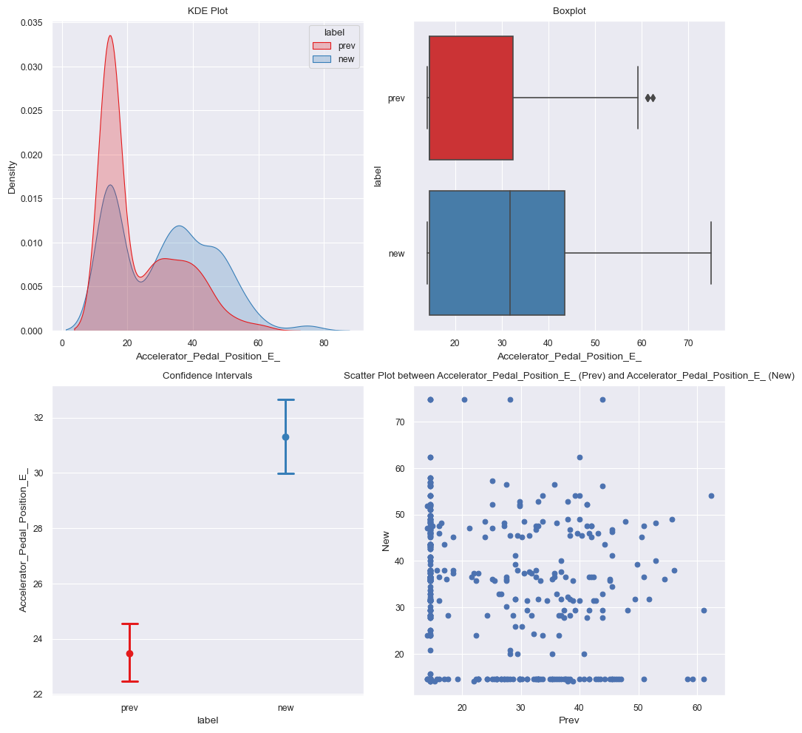
Recommendations from Fleet 2
For: Accelerator_Pedal_Position_D_
t-statistic: -8.475424384901551
P-value: 8.325735585142946e-17
The difference in means is statistically significant, recommendation possible
Mean of Accelerator_Pedal_Position_D_ (prev): 23.204
Mean of Accelerator_Pedal_Position_D_ (new): 30.441
Median of Accelerator_Pedal_Position_D_ (prev): 14.500
Median of Accelerator_Pedal_Position_D_ (new): 31.200
Standard deviation of Accelerator_Pedal_Position_D_ (prev): 11.899 Standard deviation of Accelerator_Pedal_Position_D_ (new): 14.906
For: Accelerator_Pedal_Position_E_
t-statistic: -9.18842919732572
P-value: 2.251218584192523e-19
The difference in means is statistically significant, recommendation possible
Mean of Accelerator_Pedal_Position_E_ (prev): 23.461
Mean of Accelerator_Pedal_Position_E_ (new): 31.299
Median of Accelerator_Pedal_Position_E_ (prev): 14.500
Median of Accelerator_Pedal_Position_E_ (new): 31.800
Standard deviation of Accelerator_Pedal_Position_E_ (prev): 11.930 Standard deviation of Accelerator_Pedal_Position_E_ (new): 14.857

Slide 22
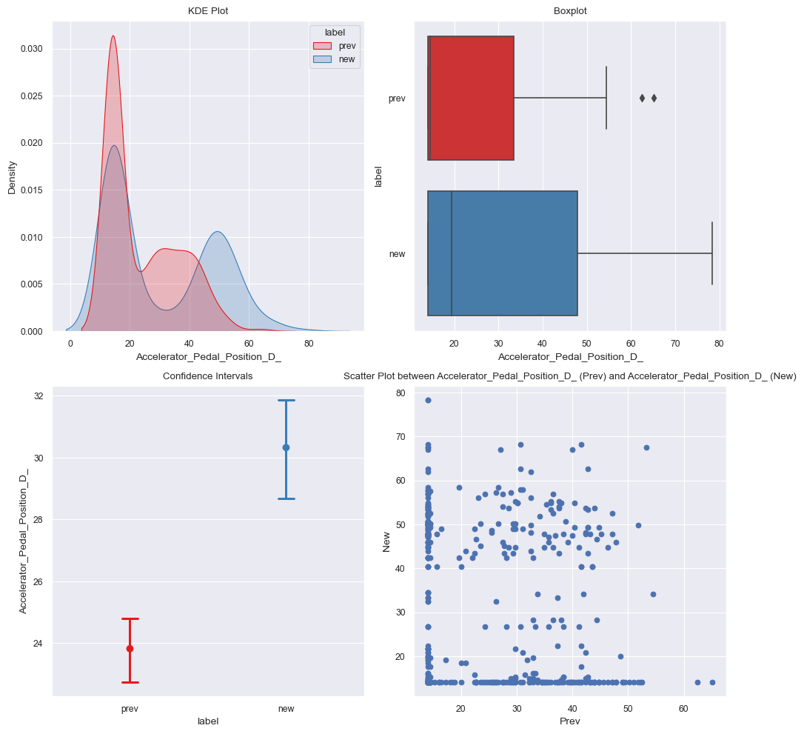
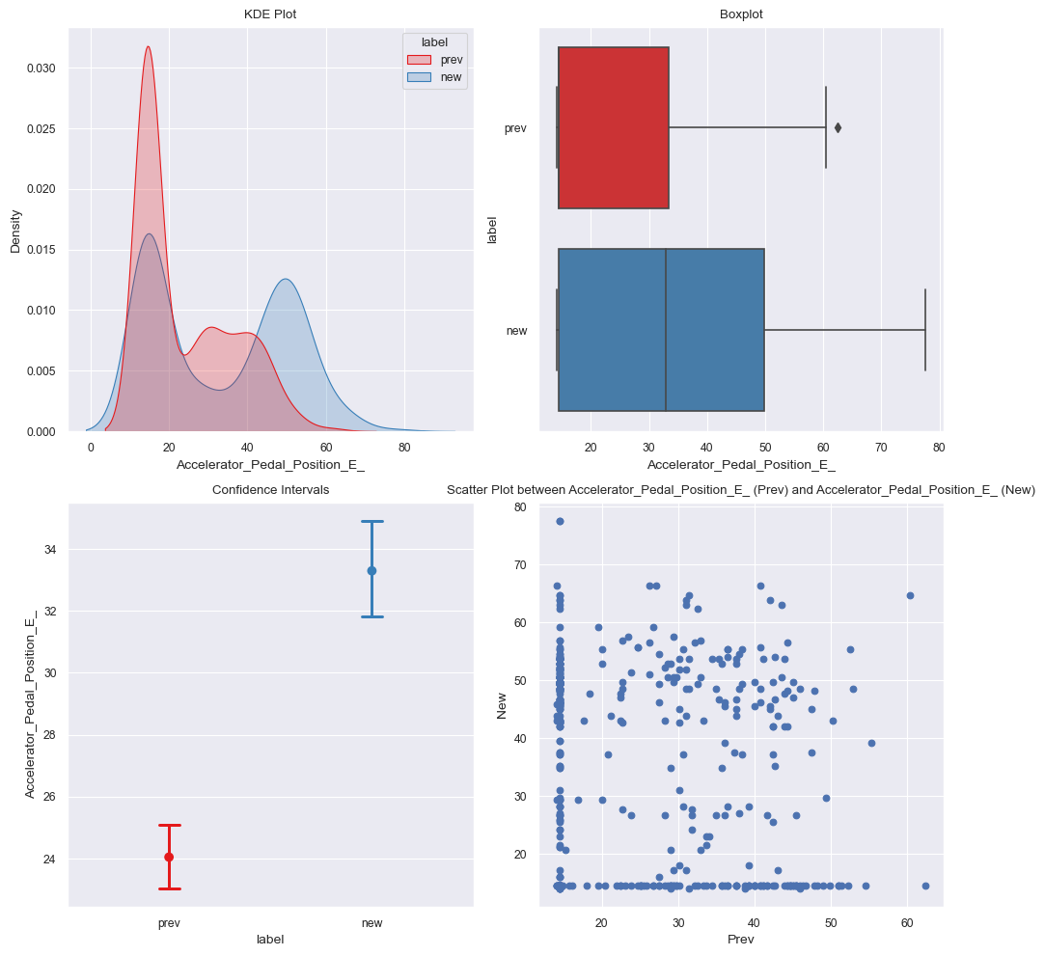
Recommendations from Fleet 3
For: Accelerator_Pedal_Position_D_
t-statistic: -6.745644668377099
P-value: 2.5767338977216535e-11
The difference in means is statistically significant, recommendation possible
Mean of Accelerator_Pedal_Position_D_ (prev): 23.823
Mean of Accelerator_Pedal_Position_D_ (new): 30.328
Median of Accelerator_Pedal_Position_D_ (prev): 14.500
Median of Accelerator_Pedal_Position_D_ (new): 19.400
Standard deviation of Accelerator_Pedal_Position_D_ (prev): 11.956
Standard deviation of Accelerator_Pedal_Position_D_ (new): 17.920
For: Accelerator_Pedal_Position_E_
t-statistic: -9.734906078108231
P-value: 1.8592771228293227e-21
The difference in means is statistically significant, recommendation possible
Mean of Accelerator_Pedal_Position_E_ (prev): 24.042
Mean of Accelerator_Pedal_Position_E_ (new): 33.297
Median of Accelerator_Pedal_Position_E_ (prev): 14.500
Median of Accelerator_Pedal_Position_E_ (new): 32.950
Standard deviation of Accelerator_Pedal_Position_E_ (prev): 11.960
Standard deviation of Accelerator_Pedal_Position_E_ (new): 17.550

Slide 23
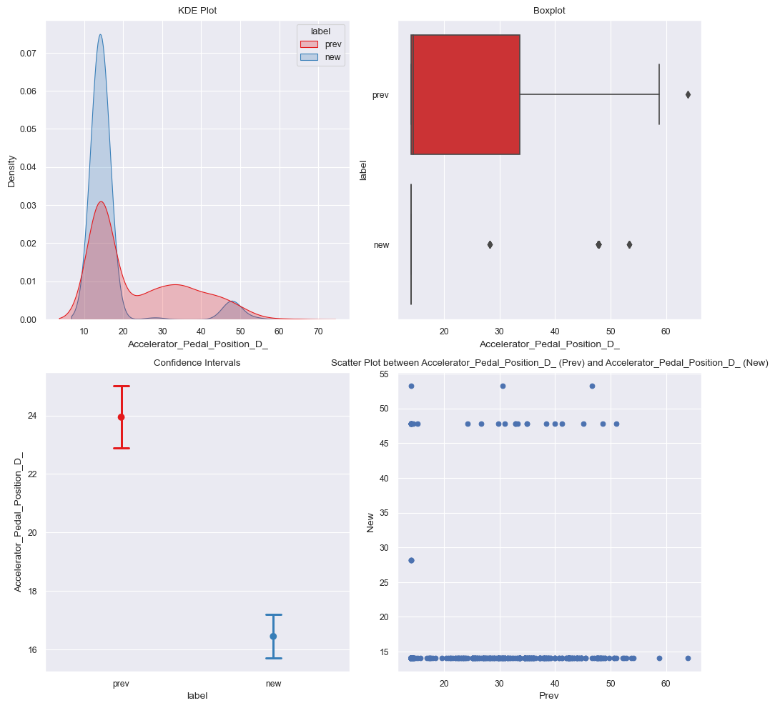
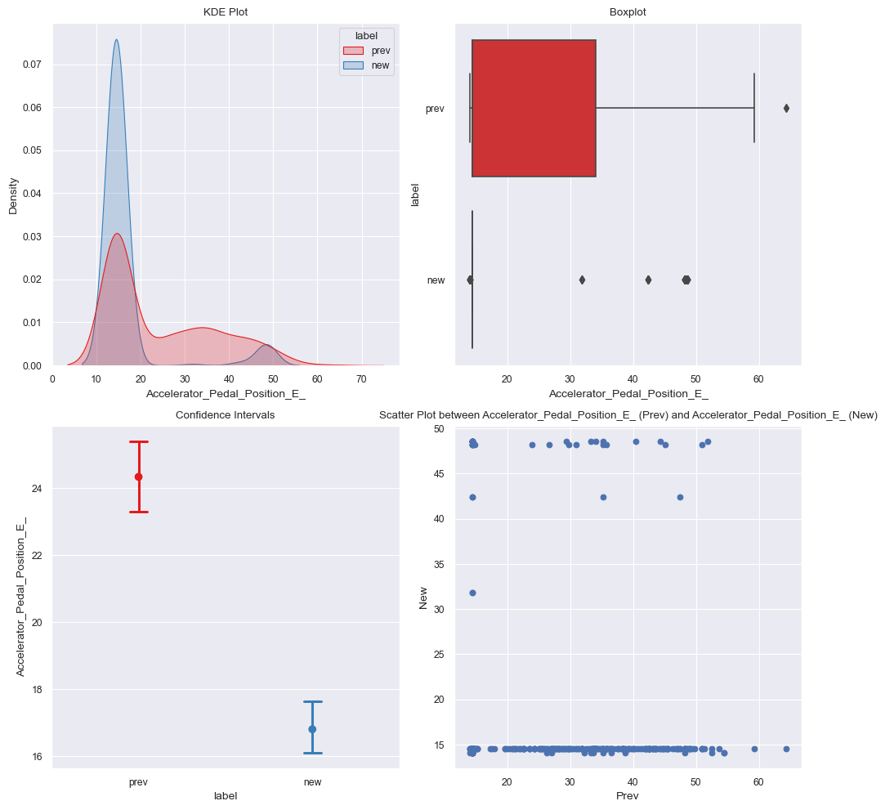
Recommendations from Fleet 4
For: Accelerator_Pedal_Position_D_
t-statistic: 11.287533983634187
P-value: 6.828946832758941e-28
The difference in means is statistically significant, recommendation possible
Mean of Accelerator_Pedal_Position_D_ (prev): 23.944
Mean of Accelerator_Pedal_Position_D_ (new): 16.442
Median of Accelerator_Pedal_Position_D_ (prev): 14.500
Median of Accelerator_Pedal_Position_D_ (new): 14.100
Standard deviation of Accelerator_Pedal_Position_D_ (prev): 12.138
Standard deviation of Accelerator_Pedal_Position_D_ (new): 8.548
For: Accelerator_Pedal_Position_E_
t-statistic: 11.311655947556982
P-value: 5.353003339888581e-28
The difference in means is statistically significant, recommendation possible
Mean of Accelerator_Pedal_Position_E_ (prev): 24.341
Mean of Accelerator_Pedal_Position_E_ (new): 16.804
Median of Accelerator_Pedal_Position_E_ (prev): 14.500
Median of Accelerator_Pedal_Position_E_ (new): 14.500
Standard deviation of Accelerator_Pedal_Position_E_ (prev): 12.263
Standard deviation of Accelerator_Pedal_Position_E_ (new): 8.437

Slide 24
Q/A

Slide 25

Thank you

